Slide 1





Anomaly Detection in Vessel’s Traffic
2nd Week, Advances

Slide 2

The data
Still waiting to get the Access 🡪 NDA´s
Already located in THUAS.
HR offices at saab reside in USA, so the formalities take longer.

Slide 3






During last week…
Monday: Presentation of the last week advances + lecture. Preparation of the meeting in THUAS (TUESDAY)
Tuesday: Meeting with Jordi in THUAS in which he brought us a presentation about Data Science in Saab. And planified the upcoming weeks.
Wednesday: Continue the research and preparing presentations of the first papers.
Thursday: Meeting in Apeldoorn with Jordi to visit Saab Offices and presenting ourselves to the team.
Friday: Keep on going with the datacamp courses at home.

Slide 4
During last week…
Monday: Presentation of the last week advances + lecture. Preparation of the meeting in THUAS (TUESDAY)
Tuesday: Meeting with Jordi in THUAS in which he brought us a presentation about Data Science in Saab. And planified the upcoming weeks.
Wednesday: Continue the research and preparing presentations of the first papers.
Thursday: Meeting in Apeldoorn with Jordi to visit Saab Offices and presenting ourselves to the team.
Friday: Keep on going with the datacamp courses at home.

Slide 5
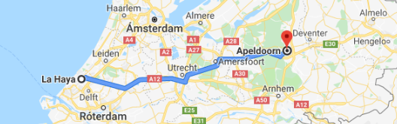
Saab Offices
From now on we will move to Apeldoorn every other Wednesday, there will take place the biweekly retrospective and planning

Slide 6


Next tasks
Research
Each member of the group is Reading and understanding a scientific paper that has to do with anomaly detection and/or vessels traffic.
In order to read faster and acquire knowledge faster, we will prepare presentations to share the information of the paper with the rest of the group.
Jordi has suggested us to start our research way to understand RNN (Time series).

Slide 7

Next tasks
Have a look at the data
Start exploring and visualizing the data. During this week , everything Will be ready after having signed the NDA’S.

Slide 8

+ Next tasks (this came up on Thursday)
The Poster
A poster design to promote our Project in saab offices.
Started a brainstorming workshop on Thursday in Apeldoorn.

Slide 9
During last week…
Monday: Presentation of the last week advances + lecture. Preparation of the meeting in THUAS (TUESDAY)
Tuesday: Meeting with Jordi in THUAS in which he brought us a presentation about Data Science in Saab. And planified the upcoming weeks.
Wednesday: Continue the research and preparing presentations of the first papers.
Thursday: Meeting in Apeldoorn with Jordi to visit Saab Offices and presenting ourselves to the team.
Friday: Keep on going with the datacamp courses at home.

Slide 10
During last week…
Monday: Presentation of the last week advances + lecture. Preparation of the meeting in THUAS (TUESDAY)
Tuesday: Meeting with Jordi in THUAS in which he brought us a presentation about Data Science in Saab. And planified the upcoming weeks.
Wednesday: Continue the research and preparing presentations of the first papers.
Thursday: Meeting in Apeldoorn with Jordi to visit Saab Offices and presenting ourselves to the team.
Friday: Keep on going with the datacamp courses at home.

Slide 11
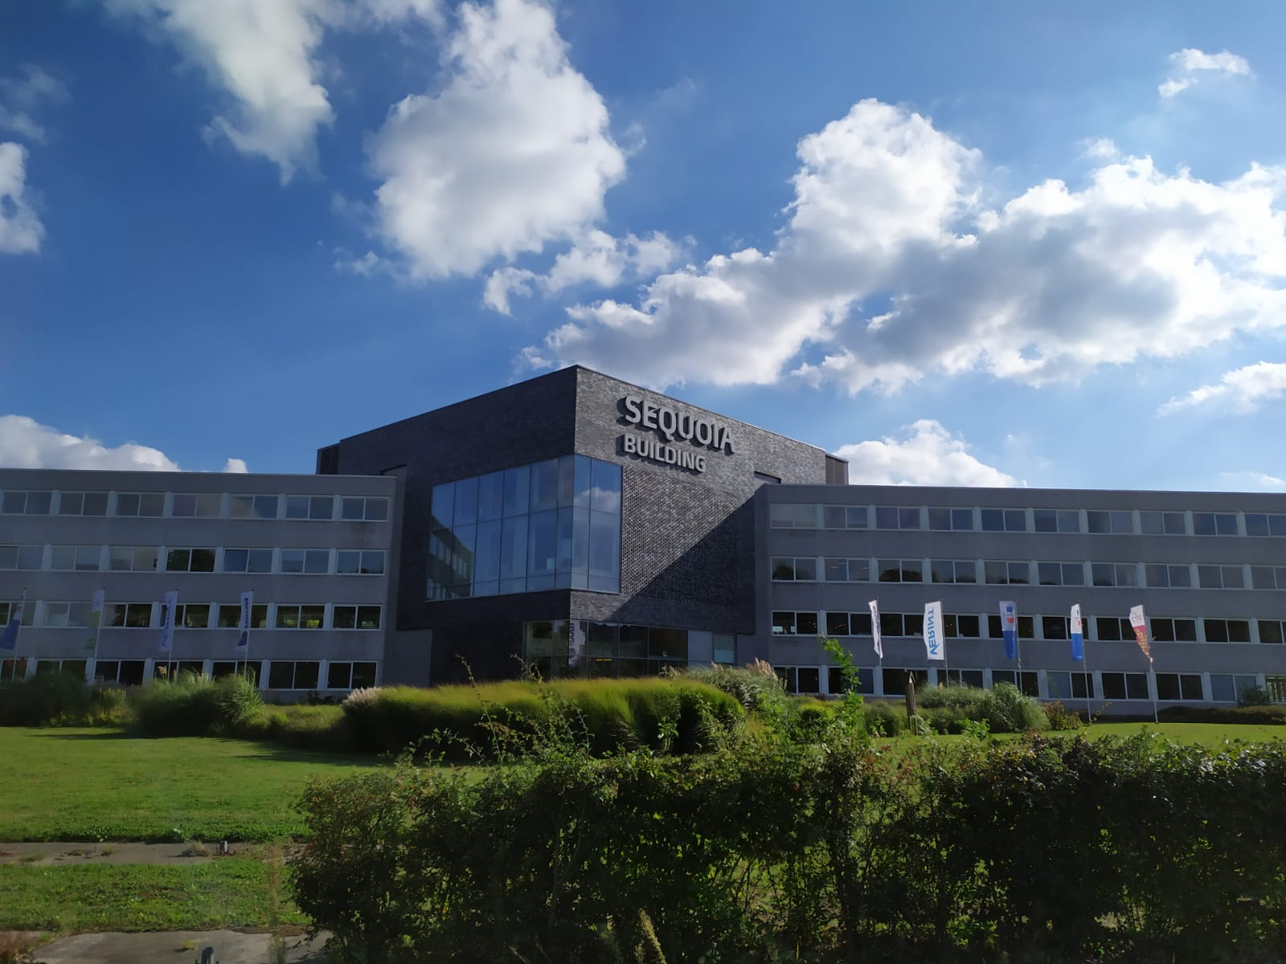
Visiting Saab…
Presenting ourselves to the team.
Presentation 1: Get a better approach to the company (mission, vision and values).
Poster WorkShop.
Presentation 2: Presentation on how tracker systems work and an overview of the type of products the company offers.

Slide 12
During last week…
Monday: Presentation of the last week advances + lecture. Preparation of the meeting in THUAS (TUESDAY)
Tuesday: Meeting with Jordi in THUAS in which he brought us a presentation about Data Science in Saab. And planified the upcoming weeks.
Wednesday: Continue the research and preparing presentations of the first papers.
Thursday: Meeting in Apeldoorn with Jordi to visit Saab Offices and presenting ourselves to the team.
Friday: Keep on going with the datacamp courses.

Slide 13

On this week…
Get the access and start exploring the data.
Finish the first iteration of the poster.
Keep on going with the research (+ presentations)

Slide 14
Thank you

